Slide 1
IEEE HACKATHON 2024
Team Ashborn-BLH05:
Yuvaraj jain 22bai10006 Akarshit Agrawal 23bce10264
Jerin jiss George 22bAI10036 Ashutosh jha 22bce10158
Akshat Mishra 22bce10217

Slide 2
About Our Project
Our team has put together a website covering the various encompassing technologies used in the current sporting world, and in the current 2024 Paris Olympics.
From tracking cameras, to 3D motion sensors, smart mats and VARs, we have made a one stop site to know and learn about the advancements in the sports and technology world, staying true to our theme of Sport tech.

Slide 3


Slide 4
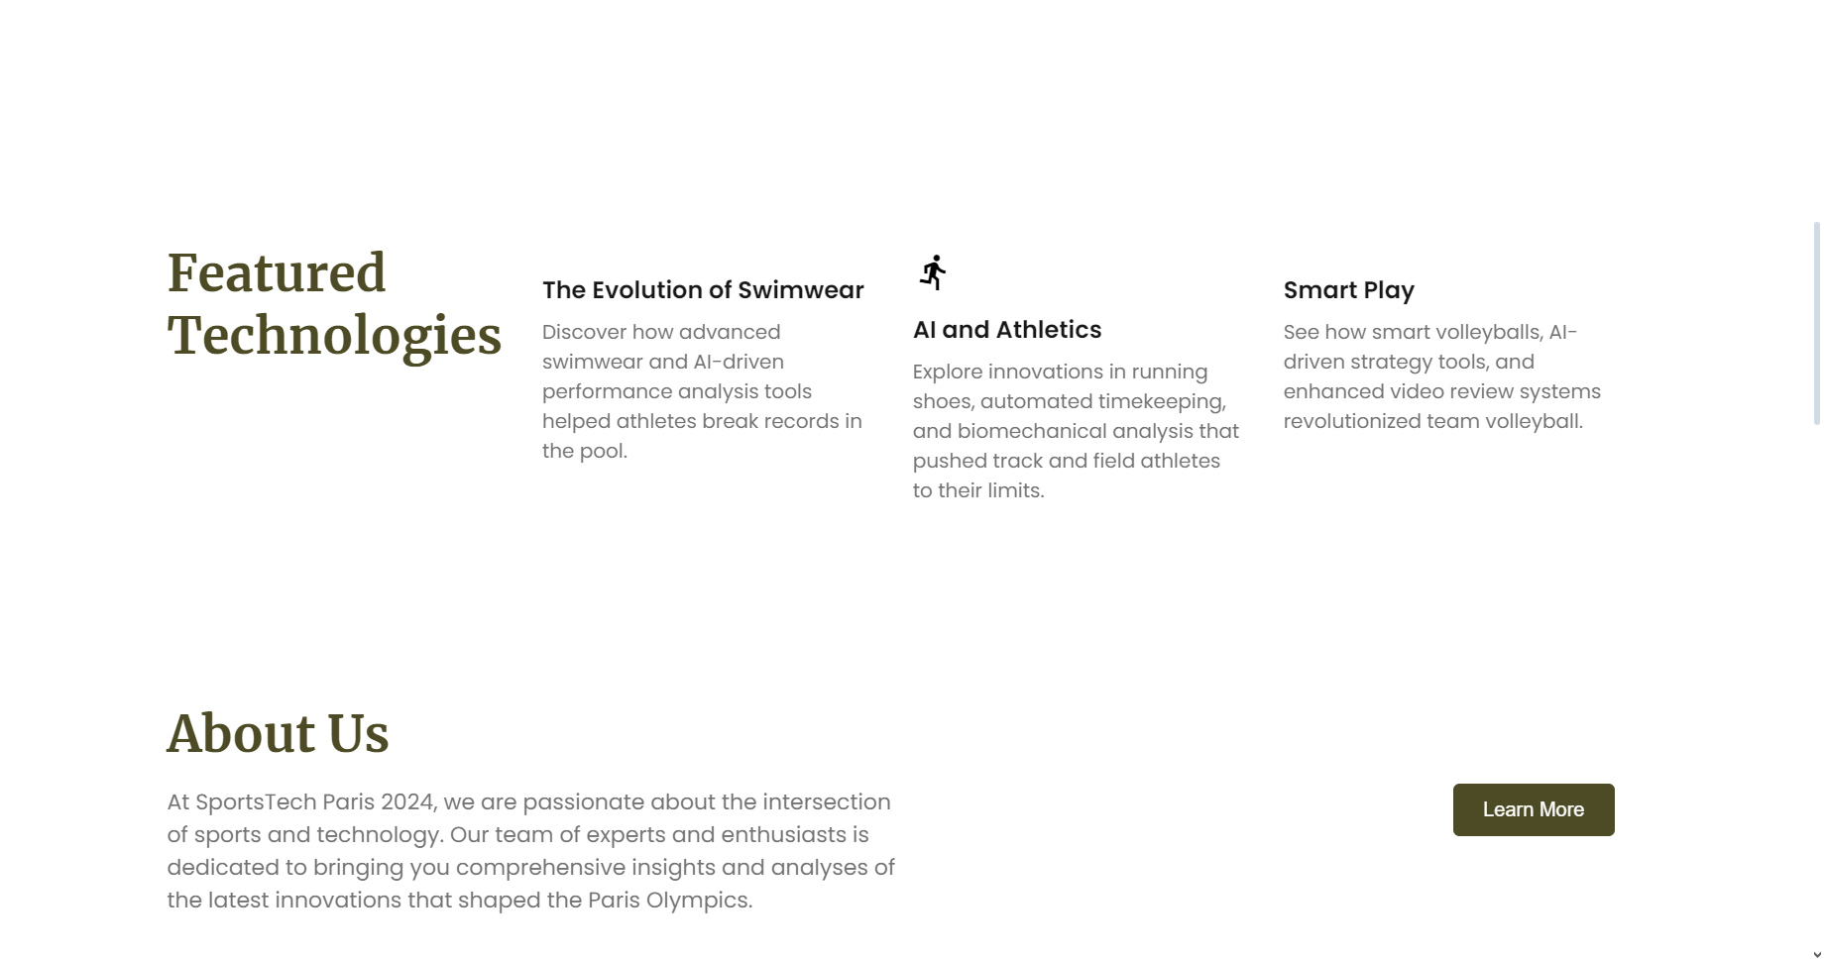

Slide 5
Topics Covered
We have covered a number of sports, ranging from swimming to fencing, and many more, with plans to increase the number of sports in the future
As the variety of the sports increases in the Olympics, comprising of even the e-sports world, there will be many more technologies that we will bring forward for people to know and learn.

Slide 6
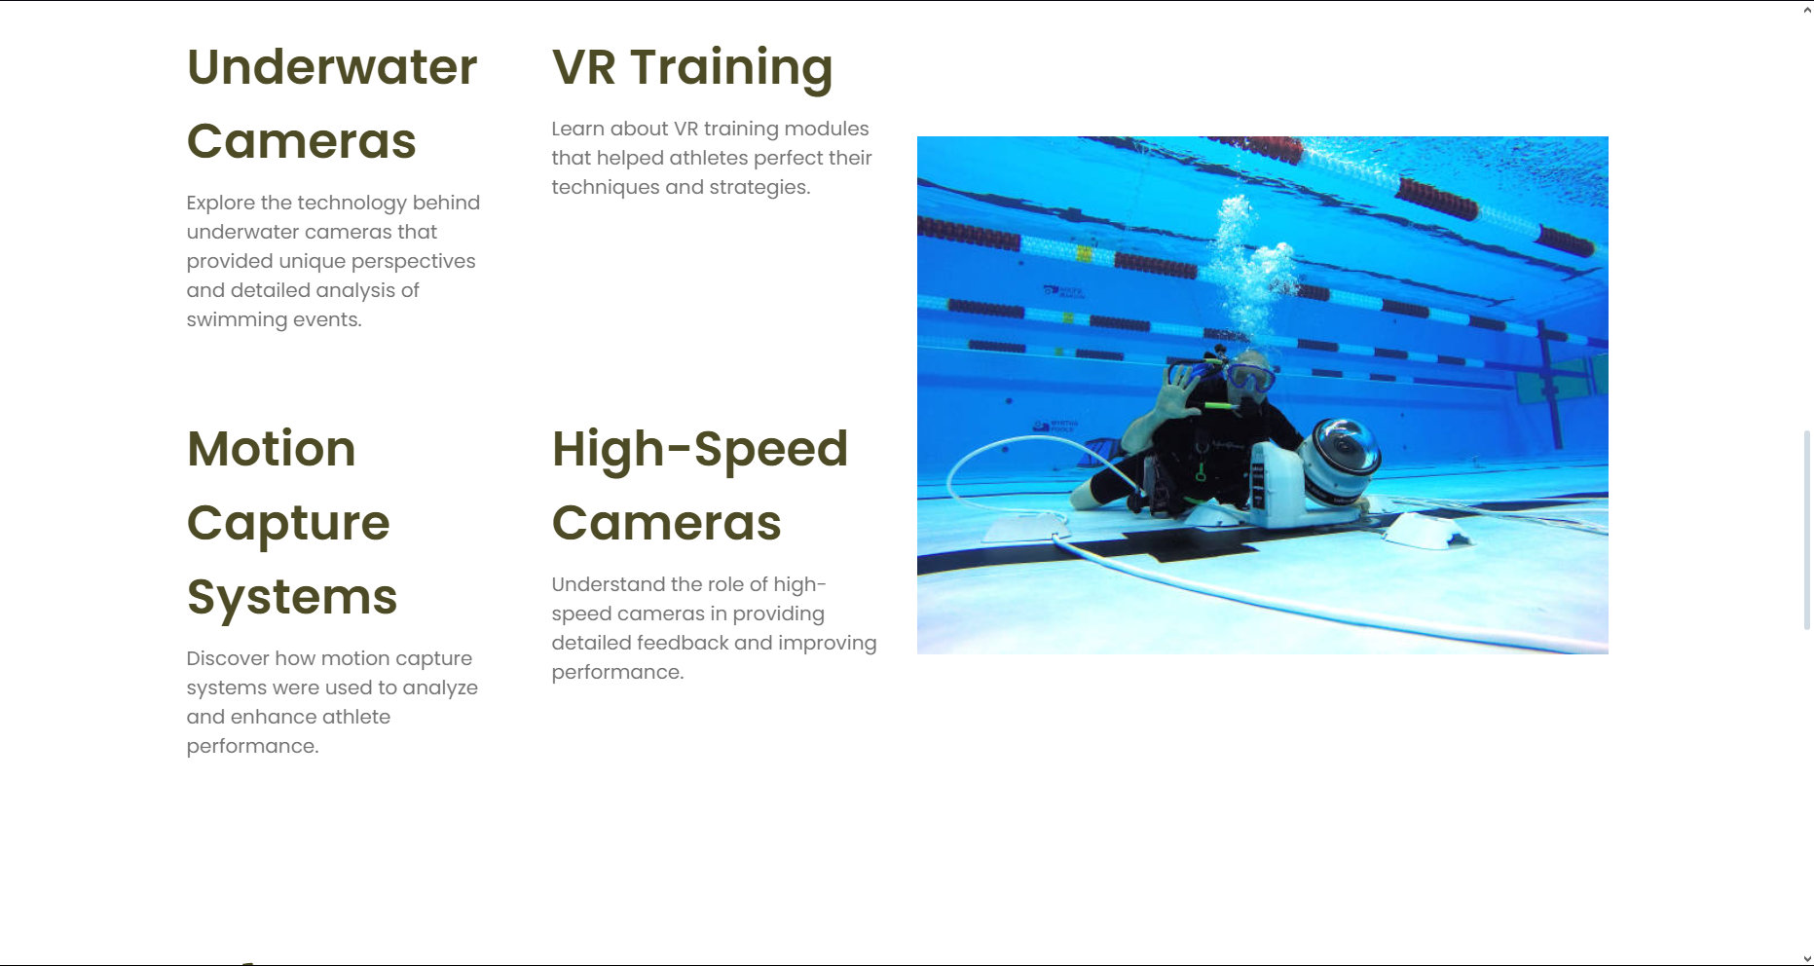

Slide 7
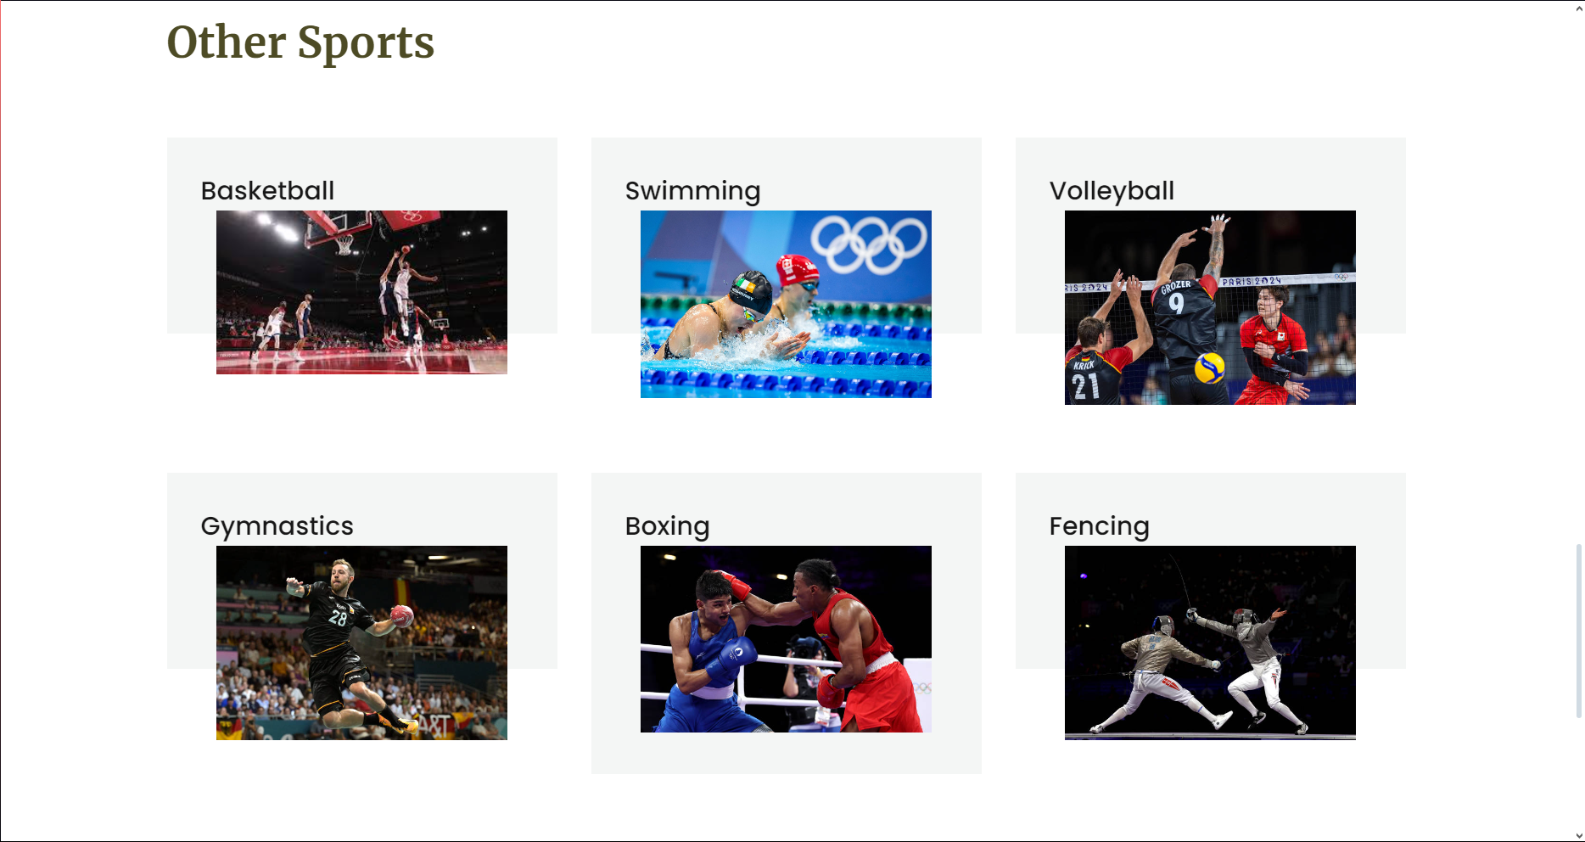

Slide 8
Why this is helpful
Easy access to all kinds of information about technologies at one place
Latest updates and changes to rules and usage of the technologies used
Comparison analysis between technologies based on usage and purpose

Slide 9
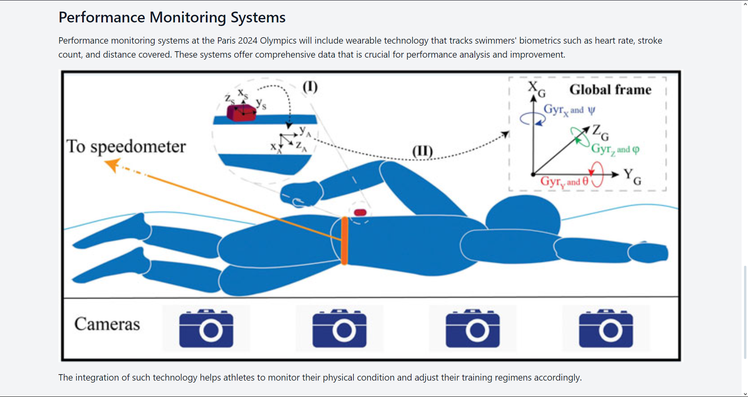

Slide 10
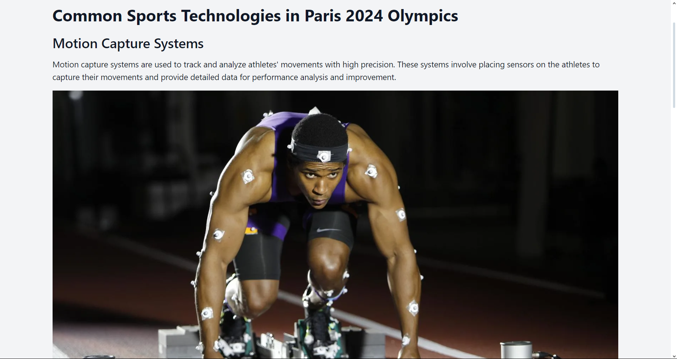

Slide 11
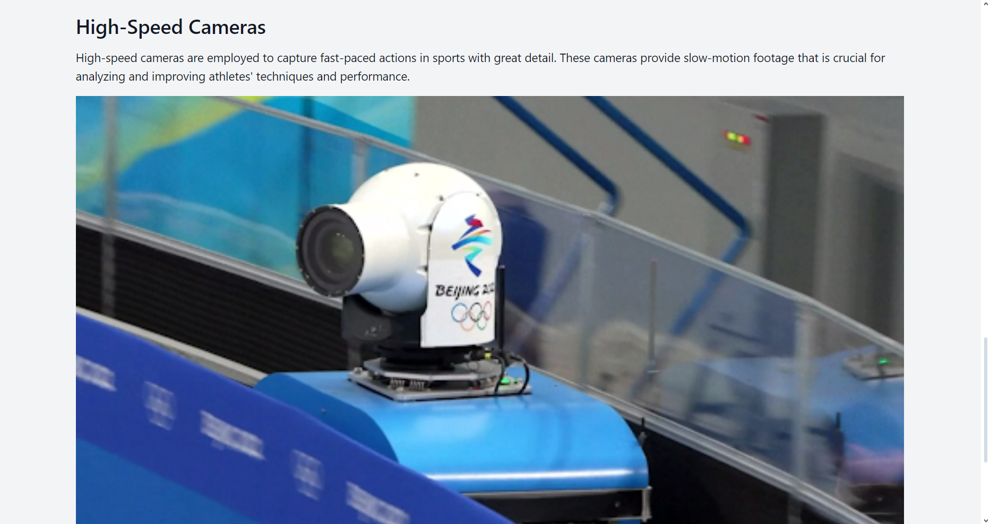

Slide 12
Future Aspects
We will be also covering upcoming Olympics and Technologies updated and introduced.
Future of technology in sport is a very wide field which have a lot more to discover.
We hope all of us can learn and innovate new technologies related to this field in future.
We will also explore the innovations in technology that will shape the future of the Olympics and other major sporting events.
The integration of cutting-edge technology in sports is a vast and exciting domain with endless opportunities for discovery and advancement.

